Slide 1
Full-custom and mixed signal design tutorial - V0.2
SS65 PDK

Slide 2
History
V0.1 - release on 02-Jan-2017 - by trangdld
V0.2 - release on 21-Feb-2017 - by trangdld

Slide 3
Content
Server access and account setup
SS65 PDK and design tools introduction
Full-custom design
Schematic
HSPICE simulation
Layout
Verification: DRC, LVS
Parasitic extraction and post-simulation
Digital design
Digital design synthesis
Digital simulation
Pad insertion
Place and Route
Error handle
Mixed-signal design
Preparing
PnR
Layout integration
Chip merger (머지)
Stream in/out

Slide 4
Download tools from IDEC ftp server
wget -r --user="cadtmp" --password=‘\!cadtmp11?' ftp://143.248.230.149/CADENCE/IC616/Linux/
tool directory that you need

Slide 5

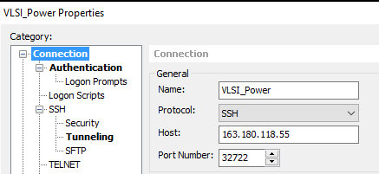
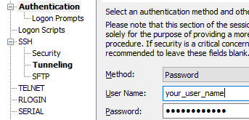
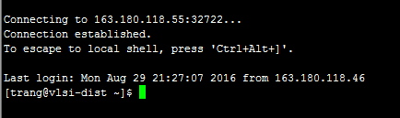
1. Server access and account setup
SS65 PDK
User
Power server
163.180.118.55:32722
SS65 server
10.8.0.1
SS65 is a secure server, that is accessed by Power server
From Windows PC, using Xshell to connect to Power server
From Linux PC, use command: ssh -X -p 32722 {user_name_on_Power_server}@163.180.118.55
Tools
License servers
(contact admin for detail)
Any name
Click OK to connect

Slide 6

1. Server access and account setup
From Power server, using ssh command to connect to SS65 server:
ssh -X {your_user_name_on_SS65}@10.8.0.1
Change to csh mode: csh
in the working directory, set environment variables: source l6lp.env
l6lp.env is script file that contains Environment variable for using SS65 PDK and the related tools
New account
cds.lib is script file that define libraries of SS65 for Virtuoso library manager

Slide 7
1. Server access and account setup
########## SEC L6LP Environment ###################################
setenv LANG C
setenv CDS_Netlisting_Mode "Analog"
setenv DEVICELIB_ROOT /Tools/Library/MPW126/pdk_analog/S65/SS65/sec120209_0007_LR6LP_PDK_PROC_PDK_N/PDK/NORMAL/LR6LP_CDS_V1.5.0.12_SEC3.5.3.8/SEC_CDS/l6lpdk/V1.5.0.12_SEC3.5.3.8
setenv CDS_INST_DIR /Tools/Cadence/IC615
setenv CDS_AUTO_64BIT ALL
setenv SPECTRE_FEATURE_FILE /Tools/Cadence/MMSIM121/tools/spectre/etc/files/spectre.dat
#setenv XCAL_MAXD_MODE smart
#setenv PEX_RUN TURE
#setenv PEX_CORNER NORMINAL
set path = ($CDS_INST_DIR/tools/bin $CDS_INST_DIR/tools/dfII/bin $path)
source /Tools/Library/MPW126/pdk_analog/S65/SS65/SECPDK/LR6LP/REV00/rule/DRC/CalibreDRC/L6LP_CalibreDRC_V1.5.0.5_SEC1.1.0.30/DRC/sourceme_v1505.65lp
source /Tools/Library/MPW126/pdk_analog/S65/SS65/SECPDK/LR6LP/REV00/rule/PEX/CalibreXRC/CalibreXRC/XRC/LR6LP_xRC_Calibre_V1.5.0.9_SEC0.0.0.13/sourceme
source /Tools/Library/MPW126/pdk_analog/S65/SS65/SECPDK/LR6LP/REV00/rule/LVS/CalibreLVS/CalibreLVS/LVS/L6LP_CalibreLVS_V1.5.0.9_SEC0.0.0.22/sourceme
setenv HSP_HOME /Tools/Synopsys/Hspice/hspice
setenv META_QUEUE 1
#source $HSP_HOME/bin/cshrc.meta
set path=($HSP_HOME/amd64 $HSP_HOME/bin $path)
in the working directory, make a l6lp.env file
Modify the paths for compatibility if need.

Slide 8
1. Server access and account setup
# Default Library Define
DEFINE basic $CDS_INST_DIR/tools/dfII/etc/cdslib/basic
DEFINE analogLib $CDS_INST_DIR/tools/dfII/etc/cdslib/artist/analogLib
# Sample cds.lib file for the Cadence Design Framework II
# Set environment variable DEVICELIB_ROOT to installation path(l6lp.env in env directory)
# of the devicelib package.
# Important: Select the library of the desired BEOL layer stack
# SEC L6LP Library Define
DEFINE l6lp $DEVICELIB_ROOT/oa/l6lp
# SEC LR6LP Library Define for RF process
DEFINE lr6lp $DEVICELIB_ROOT/oa/lr6lp
# Technology Library
DEFINE l6lp_tech $DEVICELIB_ROOT/oa/l6lp_tech_4_20_01_00
in the working directory, make a cds.lib file

Slide 9
1. Server access and account setup
163.180.118.162 License_Server
127.0.0.1 vlsi-dist.khu.ac.kr localhost localhost.localdomain localhost4 localhost4.localdomain4
1 error in hosts setup make virtuoso fail: wrong ip order
127.0.0.1 vlsi-dist.khu.ac.kr localhost localhost.localdomain localhost4 localhost4.localdomain4
163.180.118.162 License_Server
corrected order

Slide 10
2. SS65 PDK and design tools introduction
Analog
Memory
(SRAM)
Standard cell
SS65
IO
Schematic and layout: Virtuoso
spice simulation: HSPICE
DRC, LVS, PEX: Calibre (integrated in virtuoso)
Front-end digital design synthesis: Design Compiler (DC)
Back-end: IC Compiler (ICC)
Samsung
IDEC
MPW service
CSAVLSIKHU

Slide 11
3. Full-custom design
Schematic
HSPICE simulation
Layout
Verification: DRC, LVS
Parasitic extraction and post-simulation
Design example: RC oscillator

Slide 12
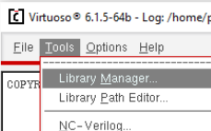
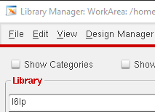
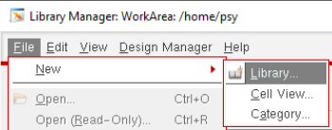

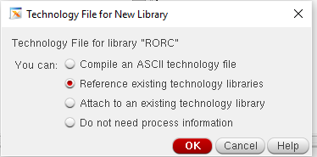
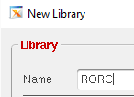
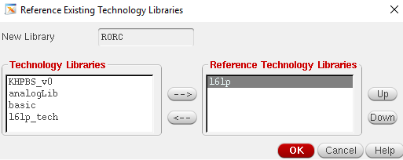
3.a. Schematic with Virtuoso
in the working directory:
virtuoso &
In Library Manager: File/New/Library
Make your own library “RORC” then click OK
Select “Reference …”
Choose “l6lp” then OK

Slide 13
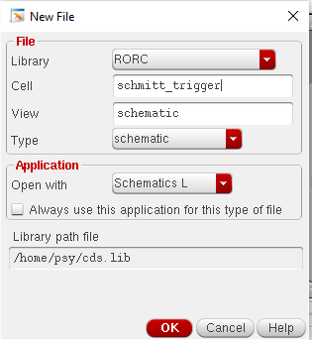
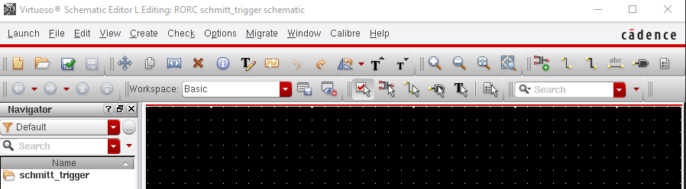
3.a Schematic
In library, select RORC
File/New/Cell Views
add Cell name: Schmitt_trigger
View schematic, then OK
Schematic Editor window will appear
Click to “Save and check”

Slide 14
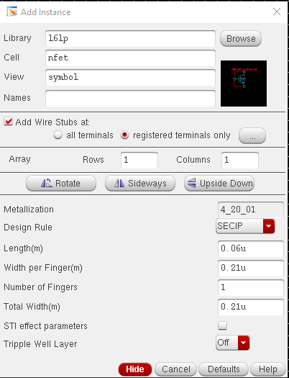
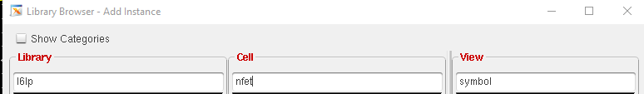
3.a Schematic
RVT: regular voltage
LVT: low voltage
In Schematic Editor: Add Instance by press key “i“
In Add Instance: click Browse then choose “l6lp” library.
Select cell “nfet” for NMOS and “pfet” for PMOS in RVT or “lvtnfet”/”lvtpfet” in LVT. Select View symbol.
Click back to Schematic Editor window to paste the instance
the instance’s properties can be change here or in Properties windows later

Slide 15
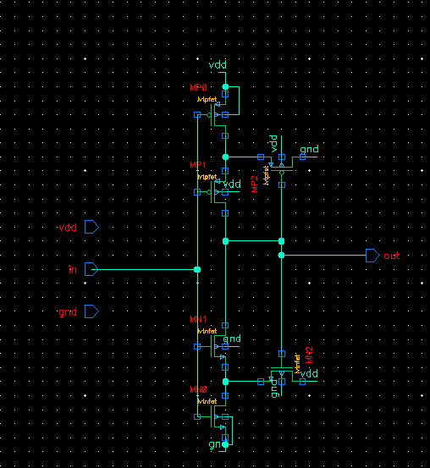
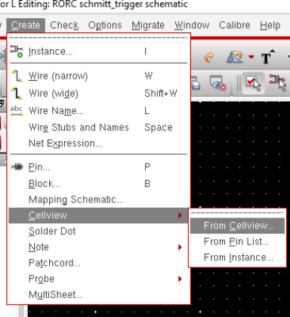
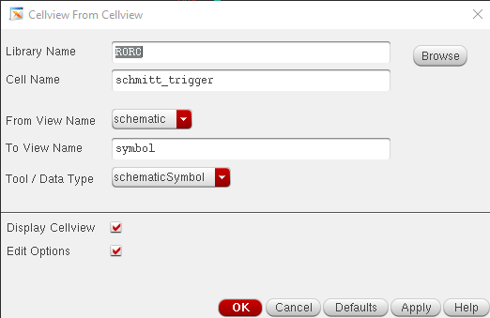
3.a. Schematic
Some basic key in Sch. Editor:
i : add Instance
w: wire connecting
l: assign label for net
p: add port
q: open Properties of an instance
m: move
d: delete
esc: cancel command
u: undo
After finish the schematic, click “save and check” for saving and checking your design. It should be no error or warning.
Make symbol: Create/Cellview/From Cellview ➔ OK

Slide 16
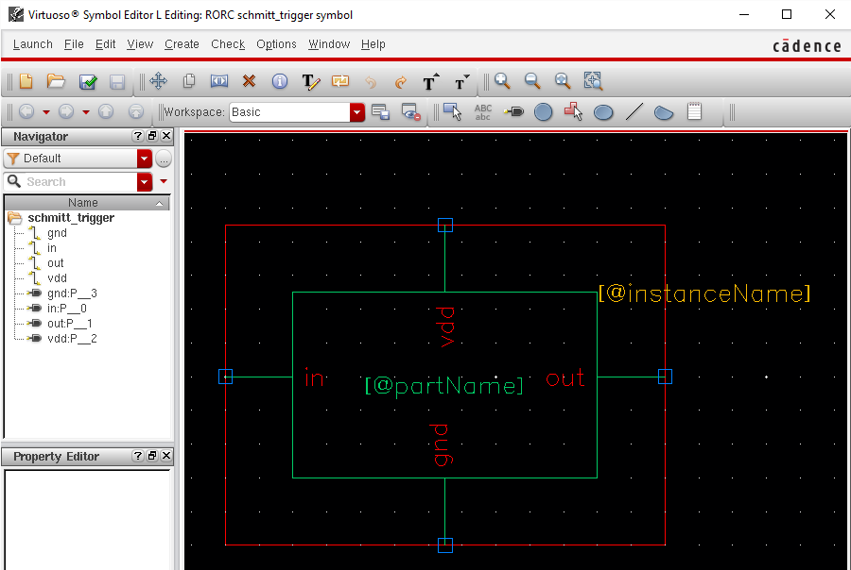
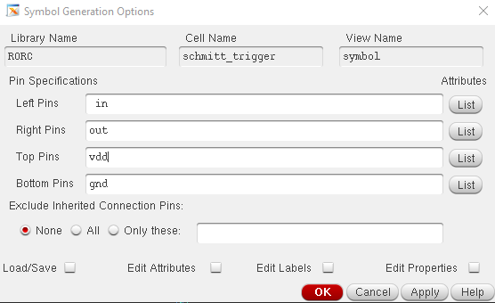
3.a. Schematic
Symbol option recommend:
Left Pins: input signals
Right: output signals
Top: Power
Bottom: Ground, reset

Slide 17
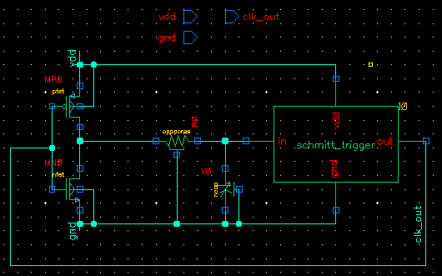

3.a. Schematic
In higher hierarchical design, we make RO cell
in designing, some properties are frequent changed so they should be name as parameters. So, later, their value can be modified easily in HSPICE simulation.

Slide 18

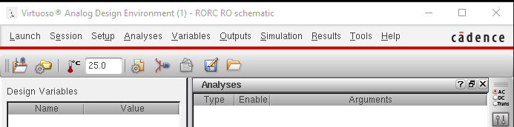

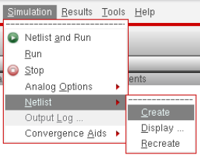
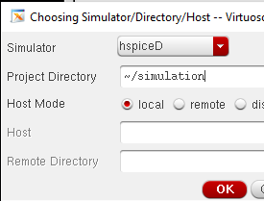
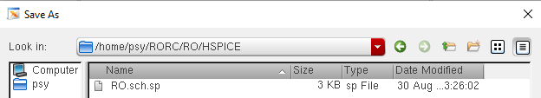
3.b. HSPICE simulation
Export HSPICE netlist from the schematic:
from Schematic Editor (RO sch), launch ADE L
in ADE L, Setup/Simulator. Choose hspiceD, then OK
in ADE L, Simulation/Netlist/Create to create HSPICE netlist.
in Netlist window, File/Save as. Save the netlist in HSPICE working directory.

Slide 19
3.b. HSPICE simulation
make a new hspice file, named as RO.sim.sp
Add library to hspice tcl file: .lib "/Tools/Library/MPW126/pdk_analog/S65/SS65/SECPDK/LR6LP/REV00/model/HSPICE/LR6LP_Hspice_V1.5.0.9_SEC2.2.6.1/HSPICE_netlist.lib" FF
Condition: NN, FF, SS, FS, SF, or MONTE
run HSPICE: hspice64 RO.sim.sp

Slide 20
3.b HSPICE simulation
for browser the simulation result (waveform), in ADE L window, choose Tools/Results Browser → Virtuoso Visualization and Analysis XL window: File/Open results

Slide 21
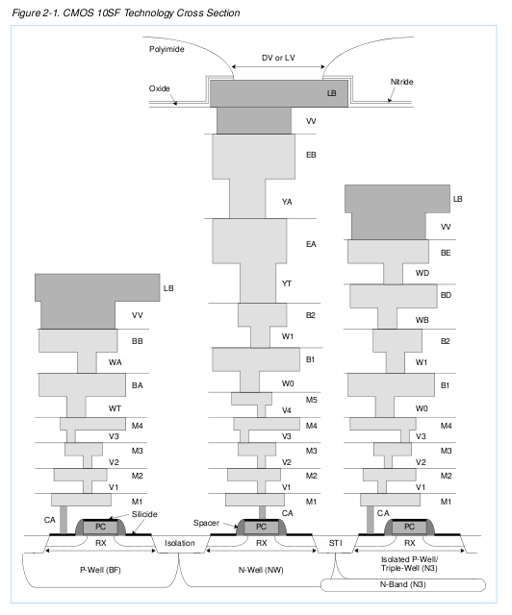
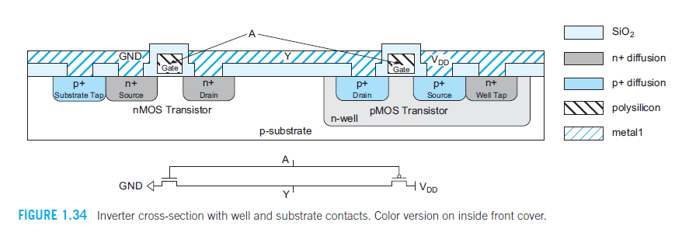
3.c. Layout
CMOS layout

Slide 22
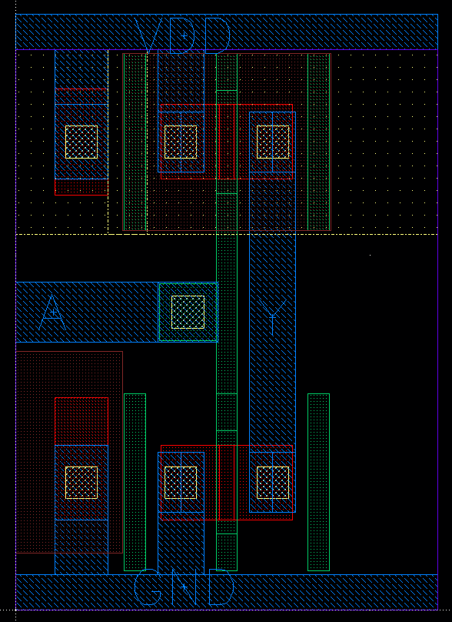
3.c. Layout
CMOS layout

Slide 23
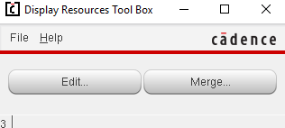
3.c Layout
Display resources: CIW→Tools→Display Resources
Merge → OK → close

Slide 24
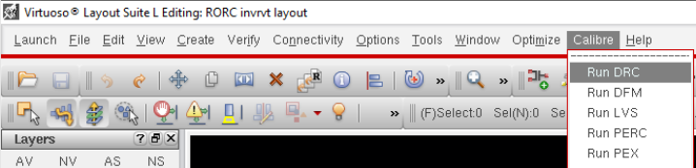
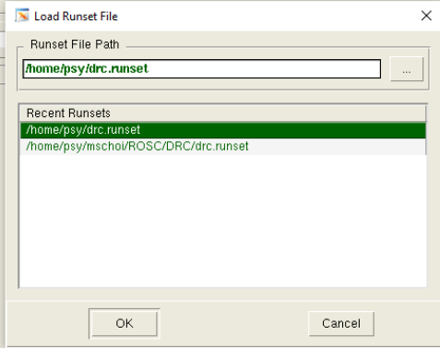
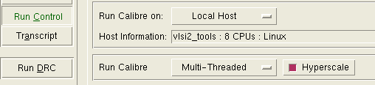
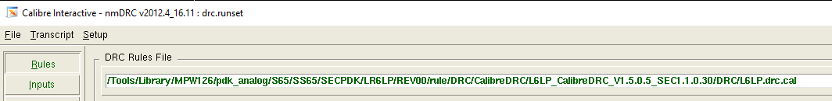
3.d. Verification: DRC

Slide 25
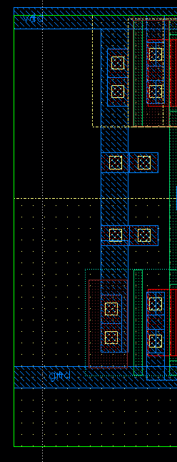
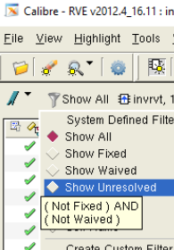
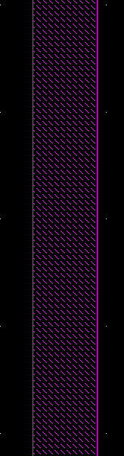
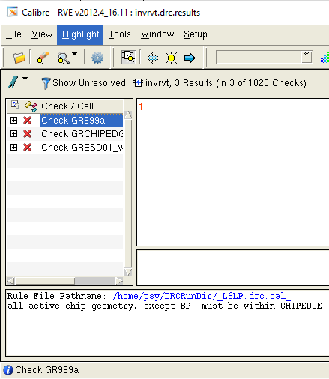
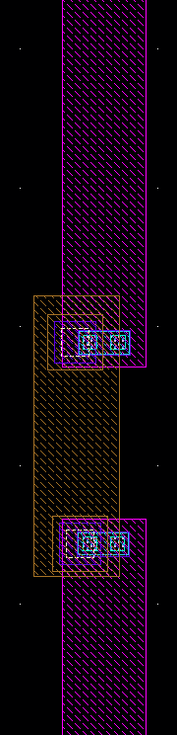
3.d. Verification: DRC
This 3 errors can be ignored
Some special errors:
GR134a “not touching gate”: happened in forward body bias, the VDD need to be connected to Nwell and Pwell by diode (RX layer)
GR131_ “ratio of (area)” : when some wire is to long or wide, this kind of error for preventing the antenna violation. Use the “hop up” technique to fix that.
missing diode
N3 (Isolated Pwell for
forward biased NMOS
Can be ignored

Slide 26
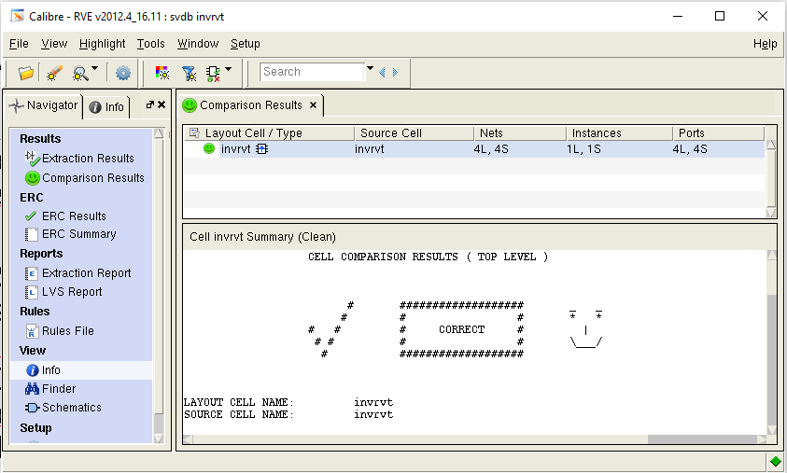
3.d. Verification: LVS
In Layout Editing window, Calibre / Run LVS. OK for runset file
The LVS rules file: “/Tools/Library/MPW126/pdk_analog/S65/SS65/SECPDK/LR6LP/REV00/rule/LVS/CalibreLVS/CalibreLVS/LVS/L6LP_CalibreLVS_V1.5.0.9_SEC0.0.0.22/L6LP_CalibreLVS_V1.5.0.9_SEC0.0.0.22”
Then Run LVS
The result should be “smile face” without any warning
Some common errors:
missing port: check label name in layout, they should be lbl layer
wrong properties: check transistor W,L, finger; for R value of resistor can be ignored

Slide 27
3.e. RC extraction and post simulation

Slide 28
4. Digital design
HDL code
(Verilog)
Digital design synthesis
Digital simulation
Pad insertion and pre-integration
Place and Route (PnR)
Chip finishing and post simulation
Function simulation (VCS)
Front End
Synthesis
(DC)
SS65 lib
Back End
simulation (VCS)
Pad insertion
post sim
PnR
GDS

Slide 29
4.a. Synthesis
Command: dc_shell
source script_file.tcl

Slide 30
4. PnR
netlist
Read design
Lib
.tdf
pin/pad physical constraints
From the working directory, start the ICC:
/Tools/Synopsys/ICC_2013.03/bin/icc_shell
In SS65nm PnR with ICC includes 9 steps
floorplan
Power plan
clock tree synthesis
Placement
post CTS opt.
.gds
Routing
.v
Finishing
Rout opt.

Slide 31
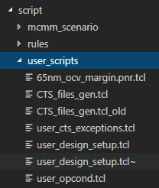
4. PnR - Read design
The input of “back end” is the results of “front end”:
netlist (.v)
standard delay constrain (.sdc)
Config ICC by modify scripts in user_scripts
To read design, in IC shell, run 00_read_design.tcl script file
source ./script/00_read_design.tcl > log_SS00.log

Slide 32
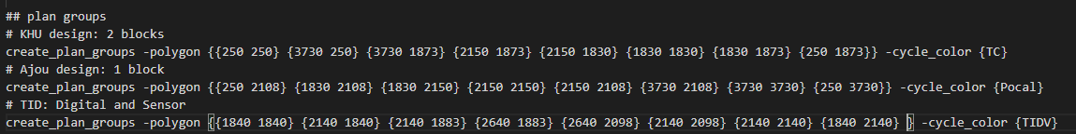
4. PnR – Floorplan
IO Pads and Power rings
In Floorplan, we decide
Core area
Position of IO pads (load tdf script)
Position of each block
After modify, in IC shell, run 01_floorplan.tcl script file
Core
memory
Digital
analog
Digital

Slide 33
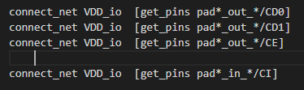


4. PnR – Powerplan
Define power connection between IO pad and power domain
VDDT
Digital
VDD_io (IO and digital core share power domain)
VDDI
VSS
IO

Slide 34
4. PnR – Powerplan
The pin CI of input pad, CD0,CD1,CE of ouput pad, and CLTCH of all pad have to connect to power domain manually
VDDT
Digital
VDD_io (IO and digital core share power domain)
VDDI
VSS
IO
In netlist _pad.v that pin have to be keep floating, however, after synthesis (using DC) that pins will automatic connect to ‘1’ or ‘0’ → we need remove manually

Slide 35
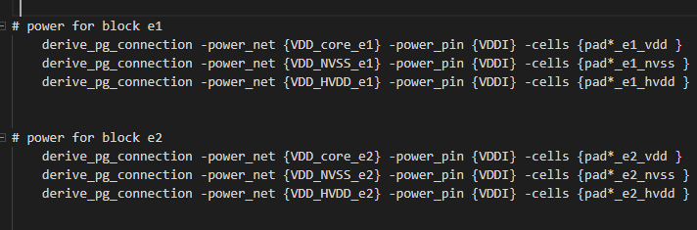
4. PnR – Powerplan
Define multiple power domain (if need)
VDD_io (IO and digital core share power domain)
VDDT
Digital
E1
E2
VDDI
VSS
IO

Slide 36
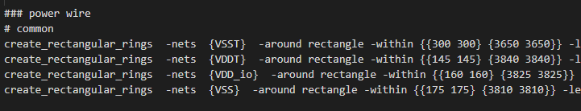
4. PnR – Powerplan
Make power ring
VDDT
Core
VDDI
VSS
IO

Slide 37
4. PnR – Powerplan
Define route guide
IO Pads and Power rings
Only using M1, M2, M3 for signal routing in this area
Core
memory
Digital
No routing in this area
analog
Digital

Slide 38
4. PnR – Other step
In IC shell, run script files:
03_place_opt.tcl
04_clock_opt_cts.tcl
05_clock_opt_psyn.tcl
06_route.tcl
07_route_opt.tcl
08_chip_finish.tcl

Slide 39
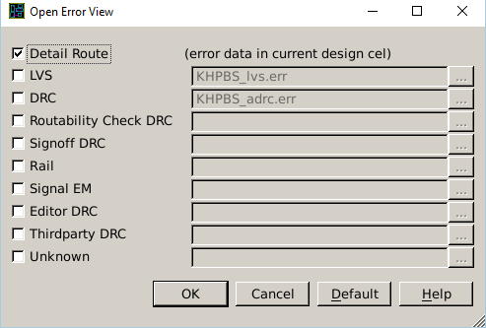
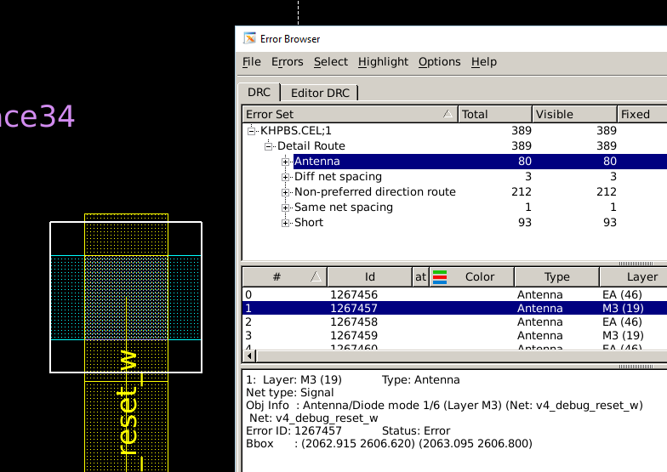
4.e. Error handle
Error browsing: In IC compiler layout window, select Verification/Error browser. Choose “Detail route” then click OK

Slide 40
4.e. Error handle
In digital design’s PnR, some critical violations:
short circuit
Diff/Same net spacing
Some clues:
Search and repair
Repartitioning (in floorplan)
Change cell density
Change placement and optimization option

Slide 41
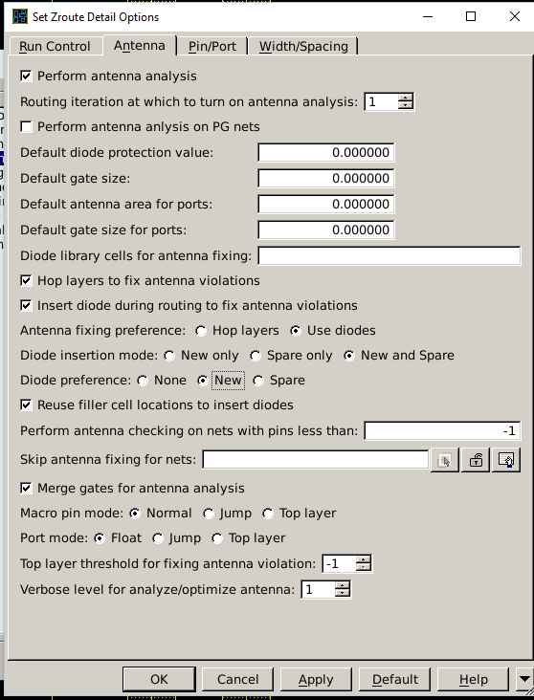
4.e. Error handle
For antenna violation fixing: Route/Detail routing → Set Detail route option … Modify those option to getting the best result.
In some case, antenna violation can not be fixed completely, they should be fix manually by hop up techinique (detail in section 5)

Slide 42
5. Mixed-signal design

Slide 43
5.a. Preparing
IO Pads and Power rings
This guideline is for manual integration without timing verification.
The full-custom blocks (macros) will be embedded into chip’s layout after PnR step of digital part.
Preparing:
macro’s size, pins position
Macro’s position (floorplan)
Power for macro
Core
Digital
Analog or Memory Macro

Slide 44
IO pad
IO Pads and Power rings
VDDT power pad (3.3V)
Core
Digital
VDDI power pad (1.2V)
GND pad
Analog pad
Analog Macro
Digital IO pad
breaker
Memory or full custom digital Macro
VDDI power pad
VDDI power pad

Slide 45
IO pad
Pad 208
top
Pad 1
IO Pads and Power rings
Position of pad is defined in padplace.tdf file
IDEC provide a standard padplace file. If we want to do bonding in IDEC, do not change the offset position
left
right
offset
(0,0)
bottom

Slide 46

IO pad
Pad 208
Pad 1
IO Pads and Power rings
Add breaker to isolate power domains
Macro
Define pin's position of macros
(0,0)

Slide 47
5.b. PnR
IO Pads and Power rings
Digital
In general, PnR for mixed design is similar with PnR for digital design. But we need some specific setup for macros
Floorplan:
Power and Pre-route:
Macro

Slide 48
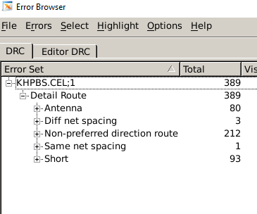
5.b. PnR: Common violation
After PnR, you will meet a lot of violation related to:
short circuit: check detail one by one, if error due to the pins (for connection with custom modules), that can be ignore.
antenna: can be fixed by:
diode insertion
hop up
manual hop up (during merging step)
Diff net spacing:
check the pins connection.
if impossible to fix manually, run “fix and route” again
Same net spacing: if impossible to fix manually, run “fix and route” again
Non-preferred … : ignore
for understanding antenna violation: http://www.edn.com/design/integrated-circuit-design/4440143/Antenna-violations-resolved-using-new-method

Slide 49
Layout merging
In the 08_chip_finish, output of PnR is a layout file .gds
In virtuoso, import that gds file

Slide 50
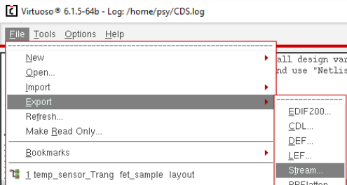
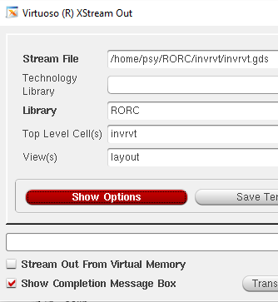
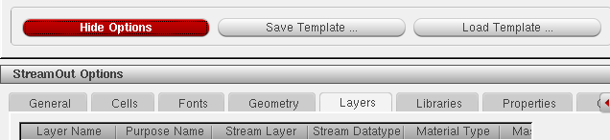
6. Stream in/out
Stream out: export layout to GDS file
From CIW window, File/Export/Stream

Slide 51
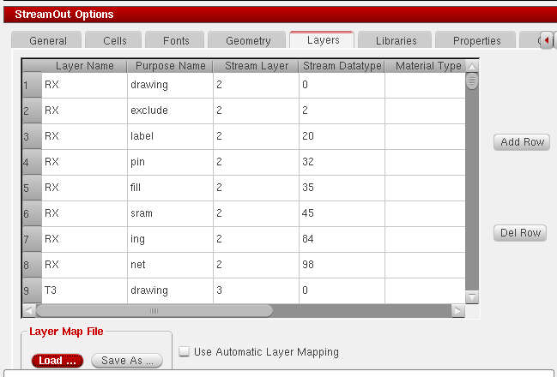

6. Stream in/out
Load tech map file.
Then “Translate”

Slide 52

6. Stream in/out
Stream in: import layout to Virtuoso
From CIW window, File/Import/Stream

Slide 53

6. Stream in/out
Choose the gds file to be import
load the tech map file (same as stream out process)
Name the imported library (new name)
Put the top cell name
Choose the tech lib: l6lp_tech
“Translate”

Slide 54
7. Merging
Have fun in IDEC!

